Slide 1
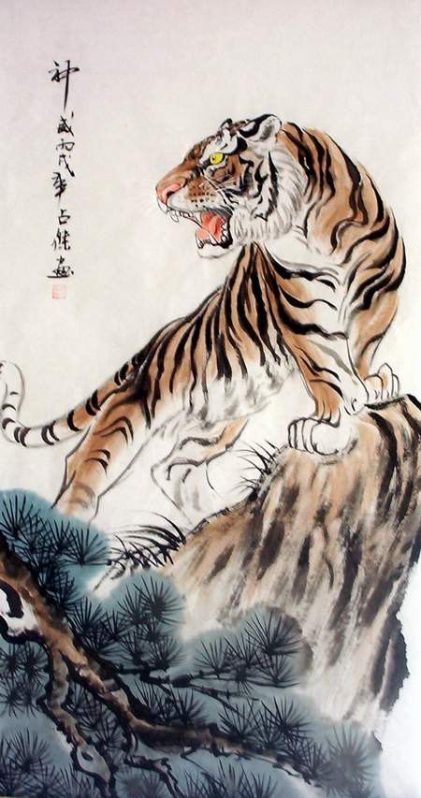
The Jungle Game
Chesshire Coders
Angélica Fallas
Taner King
Adam Gundem
Alexander Hennings
Cameron Ackerman
Image from: http://www.tattoodaze.com/tattoo-images/79/th_tiger-art-decor-mountain-tiger-tiger-hand-painting-original-bkLbwV.jpg

Slide 2
Table of contents
Changes from last iteration
Sequence diagrams
Class diagram
System test cases
JUnit test cases.
First version of the system

Slide 3
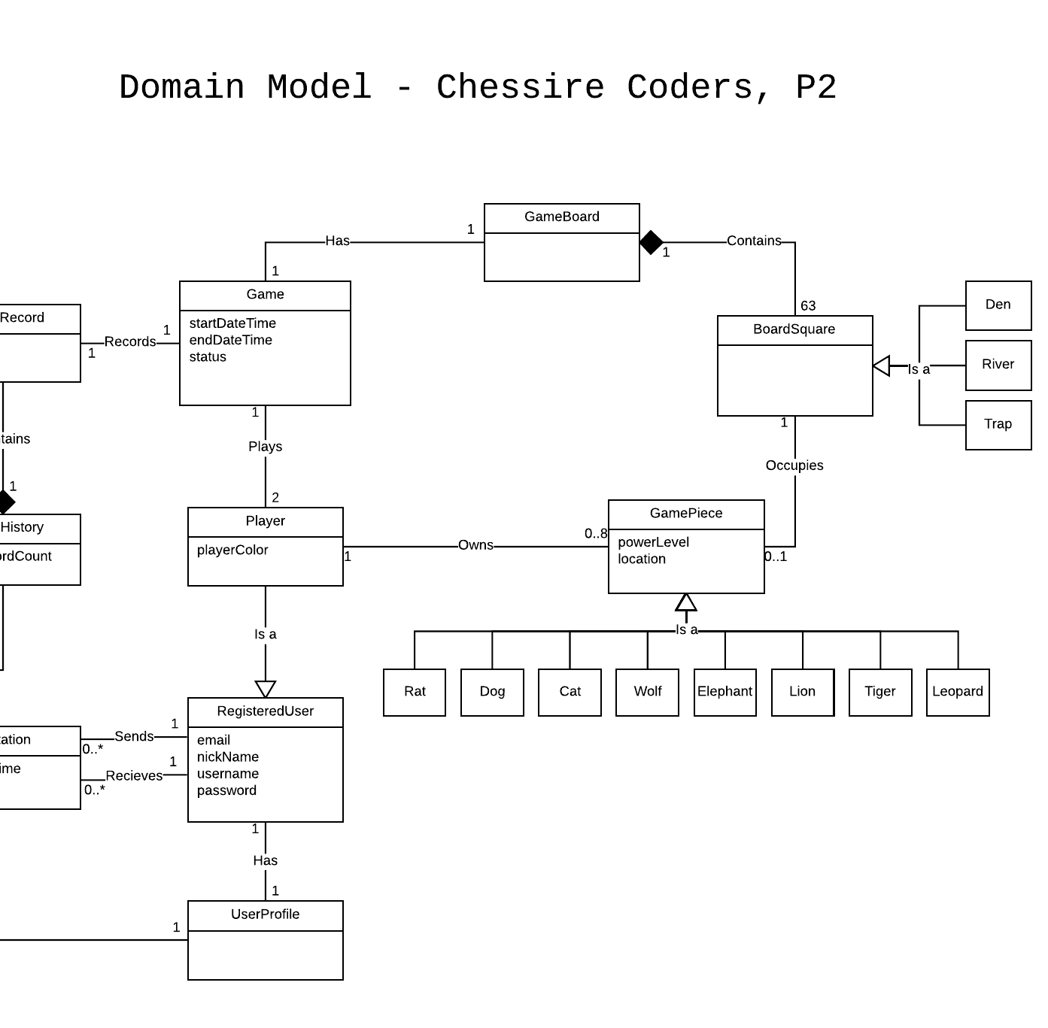
Domain Model Changes
Removed piece from BoardSquare and players from Game.
To keep notation consistent (association vs attribute vs both).

Slide 4
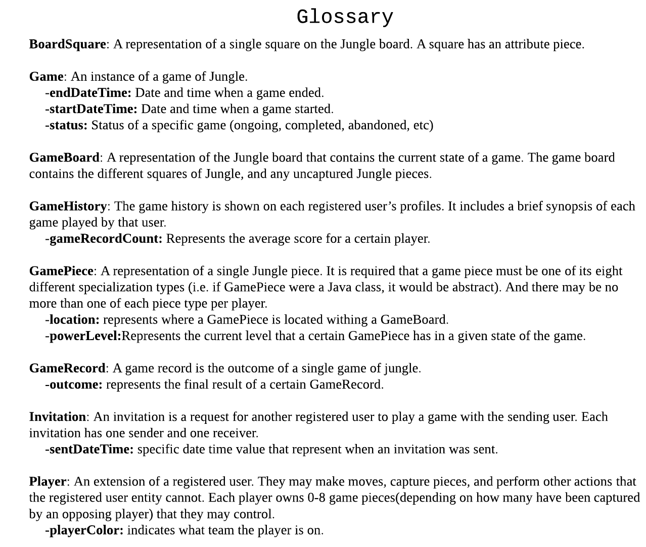
Glossary Changes
Added entries for attributes.
Sorted items alphabetically.

Slide 5
Sequence diagrams
Login
Game Invite
Game Create
Register
Take Turn

Slide 6
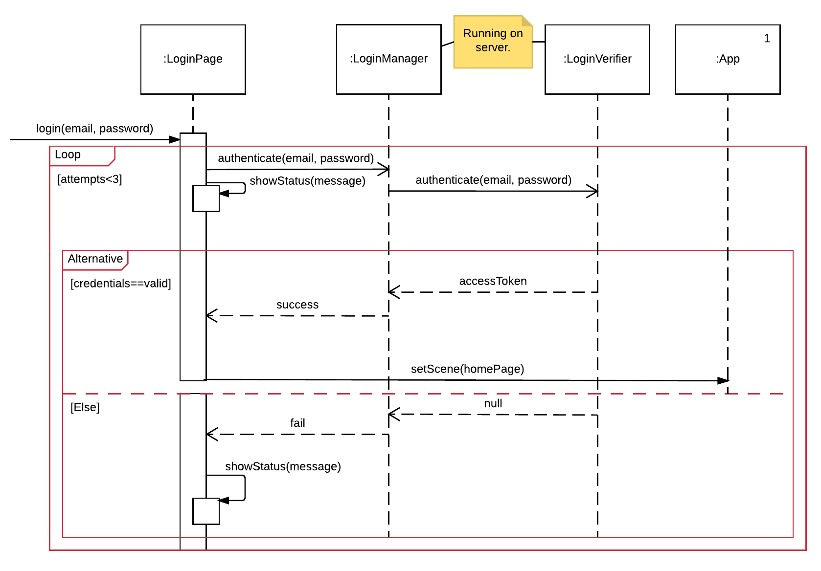
Login

Slide 7
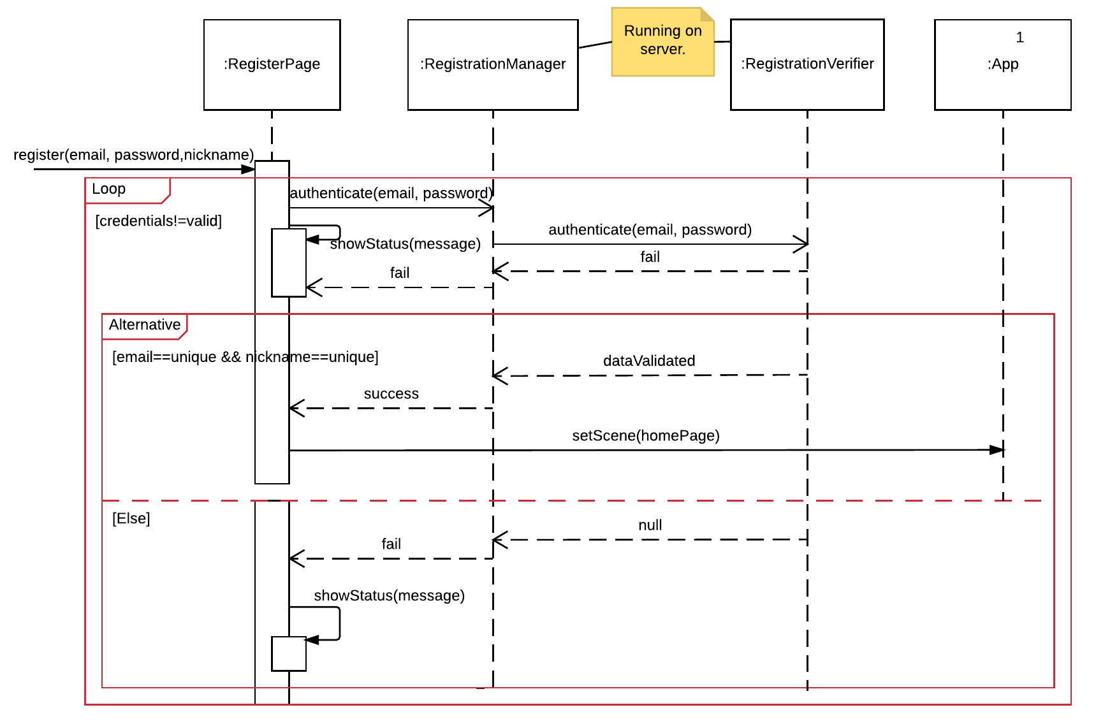
Register

Slide 8
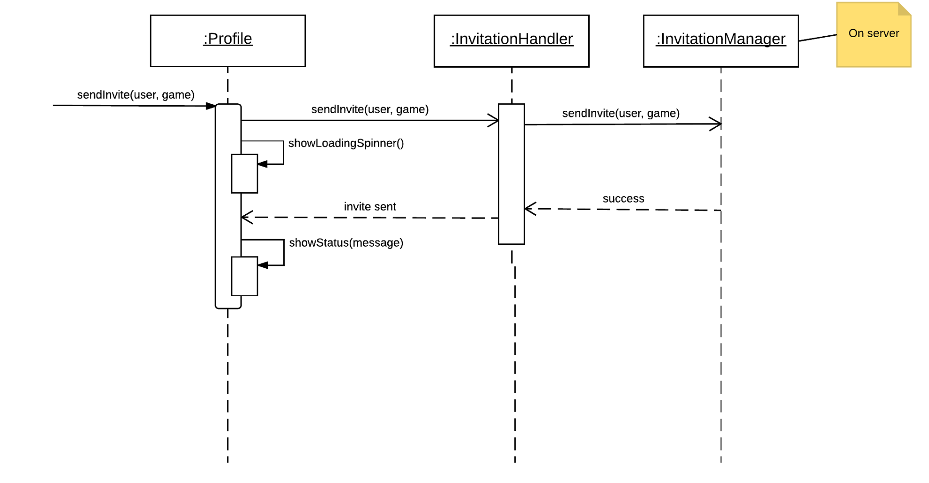
Game Invite

Slide 9
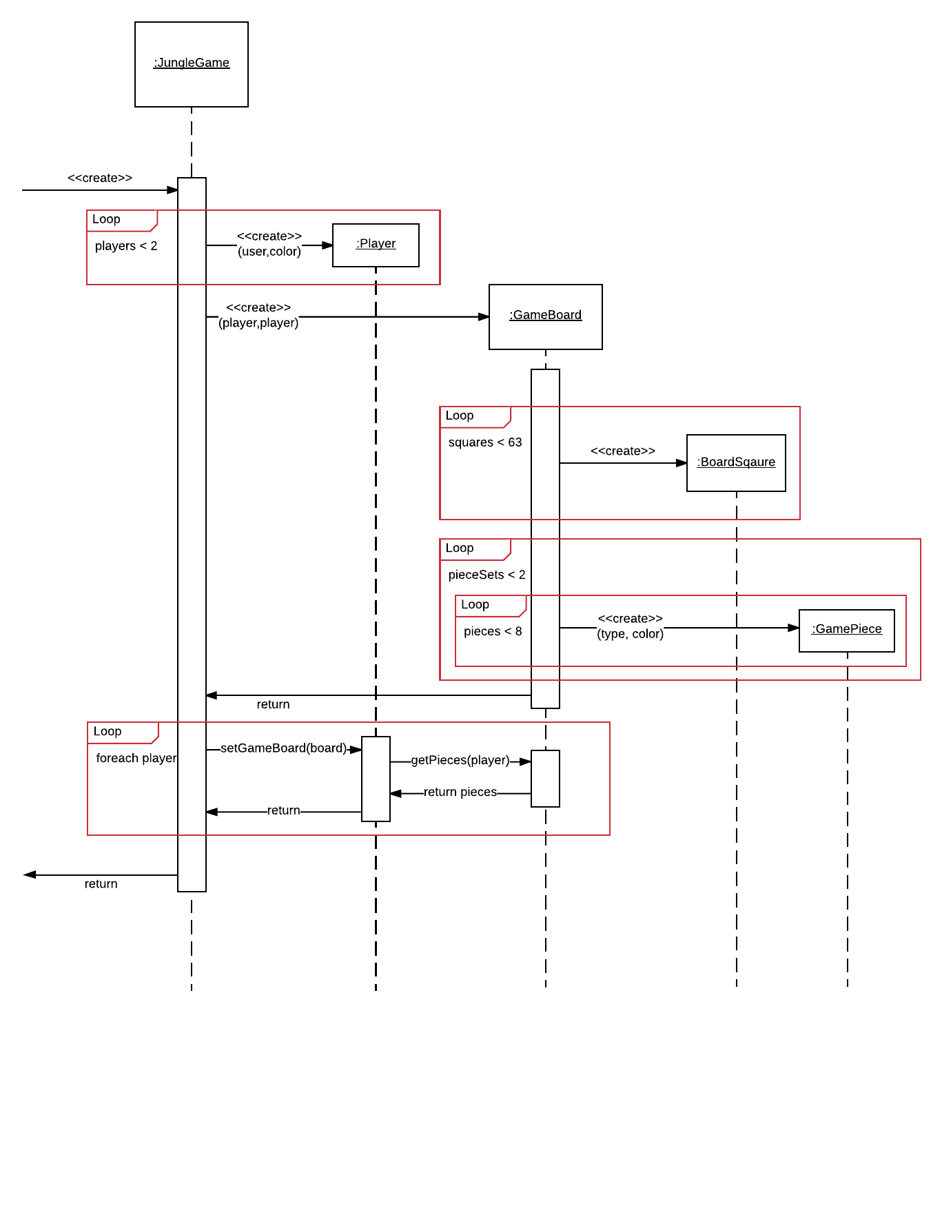
Create Game

Slide 10
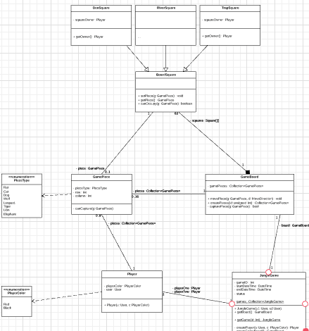
Class Diagram

Slide 11
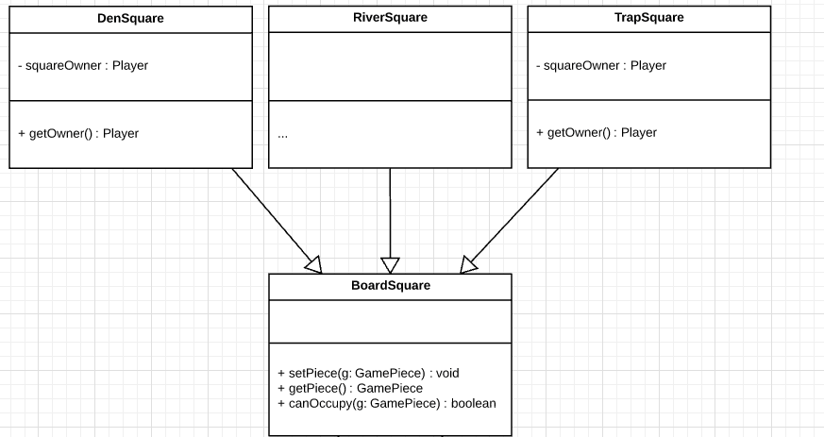
Class Diagram

Slide 12
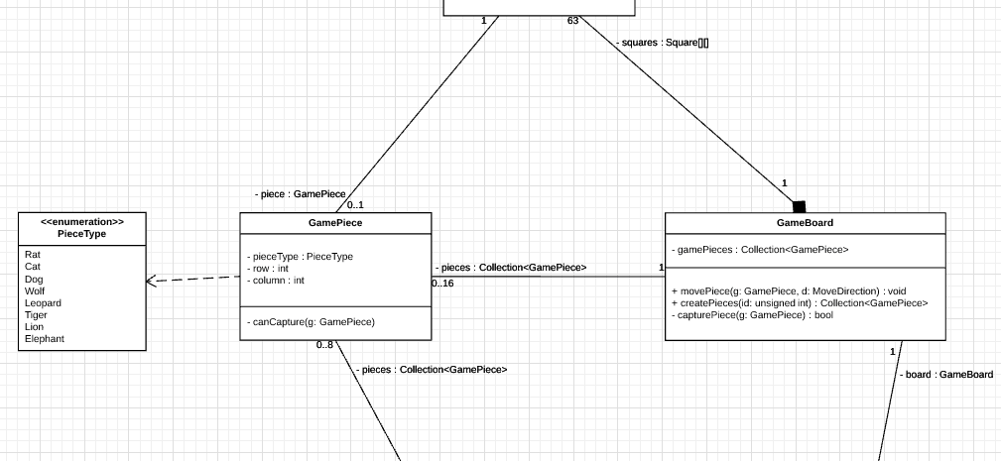
Class Diagram cont.

Slide 13
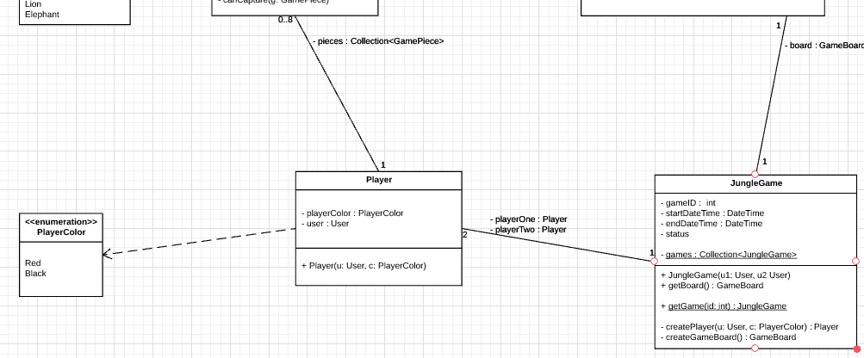
Class Diagram cont.

Slide 14
List of test cases:
TestAccountHandler
testRegisterUser
testRegisterUserAlreadyRegistered
testRegisterUserFailure
testUnregisterUser
testValidateLogin
testLogout
TestGameBoard:
testGetPieceAt_normal
testGetPieceAt_column_too_big
testGetPieceAt_column_too_small
testGetPieceAt_empty_square
testGetPieceAt_row_too_big
testGetPieceAt_row_too_small
testGetSquareAt_top_left_table_edge
testGetSquareAt_bottom_right_table_edge
testGetSquareAt_column_too_big
testGetSquareAt_column_too_small
testGetSquareAt_row_too_big
testGetSquareAt_row_too_small
testGetValidMoves_corner
testGetValidMoves_leopard
testMovePiece
TestBoardSquare:
testSetLocation_bottom_right_corner
testSetLocation_column_too_big
testSetLocation_column_too_small
testSetLocation_row_too_big
testSetLocation_row_too_small
testSetPowerLevel_zero
testSetPowerLevel_too_small
testSetPowerLevel_eight
testSetPowerLevel_too_big
testCanOccupy_river
testCanOccupy_river_rat
testCanOccupy_friendly_piece
testCanOccupy_friendly_den
testCanOccupy_square_not_adjacent_row
testCanOccupy_square_not_adjacent_column
testCanOccupy_square_not_adjacent_leopard
TestBoardSquare:
testConstructorWithPlayerColor
testClearPiece
testIsEmpty
testIsEmpty_not
testSetPiece
testSetPiece_null

Slide 15
Demo

Slide 16
Questions
And
Discussions

